Slide 1
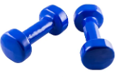
Westside High School
Jan 16-20 Week At a Glance
(WAG)

Slide 2
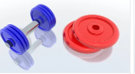
Coach Thomas
Weight Training: Jan 16-20

Slide 3
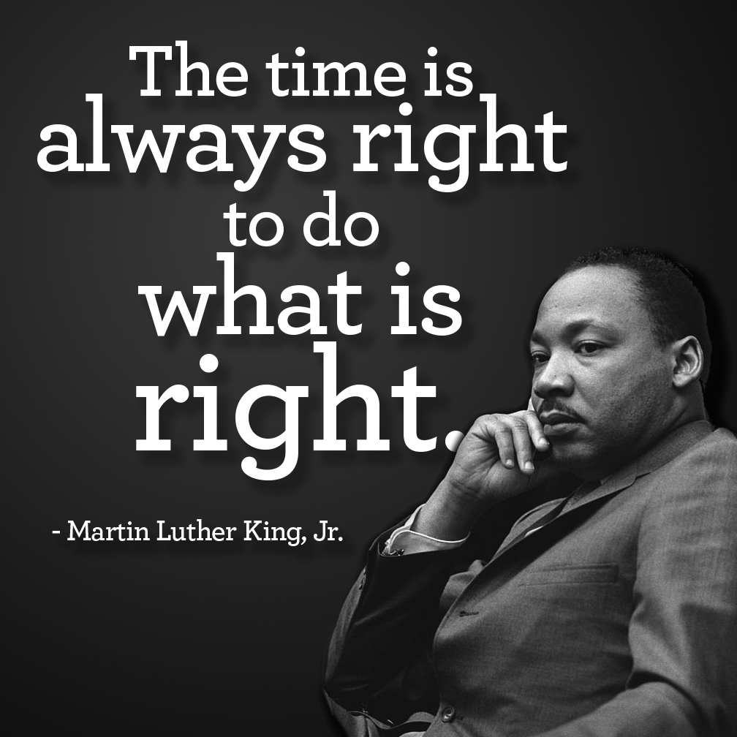
Monday - Agenda
Jan 16
Standard:
PEWT.4 The physically educated student exhibits responsible personal and social behavior
that respects self and others in physical activity settings.
a. Displays the ability to follow rules, procedures, and routines appropriate in the weight
training setting.
b. Exhibits the ability to demonstrate safe and responsible behavior.
c. Identifies the difference between encouraging and discouraging progression while
training.
d. Demonstrates the ability to apply the rules and etiquette of various weight training
activities
Learning Target
I can identify the muscle group/area of focus for strength training exercises
I can use the proper technique and form to perform various strength training exercises
Opening ( 10-15 mins)
2-3 minute cardio: jump rope, jump & jax, jog in place
2 minute stretches
Work-session ( 20 - 25 mins)
Locker-room
Coach will demonstrate exercises and inform students of the sets & time/rep
Upper & Lower Body (split males & females)
Upper: bench, bicep curls, chest press, shoulder press, frontal lifts, bent over row
Lower: dead lifts, lunges, high knees, calf raises, leg ext (kettle bell), tuck jumps (stage)
Criteria for Success
I can use the proper form and technique to perform resistance training exercises
Closing ( 05 – 10 mins)
Locker Room & cool down stretches

Slide 4
Tuesday - Agenda
Learning Target
Jan 17 Standard:
Full body
PEWT.4 The physically educated student exhibits responsible personal and social behavior
that respects self and others in physical activity settings.
a. Displays the ability to follow rules, procedures, and routines appropriate in the weight
training setting.
b. Exhibits the ability to demonstrate safe and responsible behavior.
c. Identifies the difference between encouraging and discouraging progression while
training.
d. Demonstrates the ability to apply the rules and etiquette of various weight training
activities
Opening ( 10-15 mins)
Same as previous day
Work-session ( 20 - 25 mins)
Locker-room
Coach will demonstrate exercises and inform students of the sets & time/rep
Upper & Lower Body (split males & females)
Upper: bench, bicep curls, chest press, shoulder press, frontal lifts, bent over row
Lower: dead lifts, lunges, high knees, calf raises, leg ext (kettle bell), tuck jumps (stage
3. Complete Training Journal after lunch
Criteria for Success
Same as previous day for lower body & core
Closing ( 05 – 10 mins)
Cool down stretches

Slide 5
Wednesday - Agenda
Learning Target
Jan 18 Standard:
Opening ( 10-15 mins)
5 minute Walk
Work-session ( 20 - 25 mins)
Locker-room
Coach will demonstrate exercises and inform students of the sets & time/rep
Upper & Lower Body (split males & females)
Upper: bench, bicep curls, chest press, shoulder press, frontal lifts, bent over row
Lower: dead lifts, lunges, high knees, calf raises, leg ext (kettle bell), tuck jumps (stage
3. Complete training journal after lunch
Criteria for Success
Closing ( 05 – 10 mins)
-locker room unlocked for 5 minutes

Slide 6
Thursday - Agenda
Jan 19 Standard:
PEWT.4 The physically educated student exhibits responsible personal and social behavior
that respects self and others in physical activity settings.
a. Displays the ability to follow rules, procedures, and routines appropriate in the weight
training setting.
b. Exhibits the ability to demonstrate safe and responsible behavior.
c. Identifies the difference between encouraging and discouraging progression while
training.
d. Demonstrates the ability to apply the rules and etiquette of various weight training
activities
Learning Target
Same as Tuesday
Opening ( 10-15 mins)
2 minute cardio & stretch
Work-session ( 20 - 25 mins)
Locker-room
Coach will demonstrate exercises and inform students of the sets & time/rep
Upper & Lower Body (split males & females)
Upper: bench, bicep curls, chest press, shoulder press, frontal lifts, bent over row
Lower: dead lifts, lunges, high knees, calf raises, leg ext (kettle bell), tuck jumps (stage
3. Complete training journal after lunch
Criteria for Success
Student perform exercises using proper technique & giving 100% effort
Closing ( 05 – 10 mins)
-locker room unlocked for 5 minutes
-students use remaining time to cool down & rehydrate if necessary

Slide 7
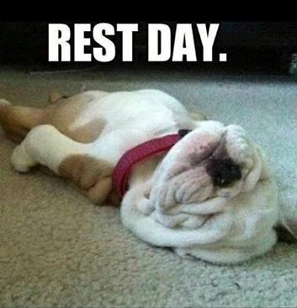
Friday - Agenda
Learning Target
Freestyle Friday
Jan 20 Standard:
PEWT.4 The physically educated student exhibits responsible personal and social behavior
that respects self and others in physical activity settings.
a. Displays the ability to follow rules, procedures, and routines appropriate in the weight
training setting.
b. Exhibits the ability to demonstrate safe and responsible behavior.
c. Identifies the difference between encouraging and discouraging progression while
training.
d. Demonstrates the ability to apply the rules and etiquette of various weight training
activities
Opening ( 10-15 mins)
Attendance
Work-session ( 20 - 25 mins)
Students are able to engage in various activities/sports typically those that they are most interested
Teacher will conference will students and possibly make parent phone calls/contact as needed
MaKEUP DAY IF NECCESSARY
Criteria for Success
n/a
Closing ( 05 – 10 mins)
N/A

Slide 8
Resources
https://www.nike.com/nrc-app
https://www.rcboe.org/westside

